Slide 1
Walmart sales forecasting model
By Rahul Singh

Slide 2
Problem/project goal
Common problem is companies’ need sales forecasting to predict any low-income months and have market strategy to keep record sales. This can help marketing department with strategic insights and strategy.
Goal: Create a model that can capture sales forecast for up to 6 months.

Slide 3
Data wrangling
Data source: Kaggle
https://www.kaggle.com/competitions/walmart-recruiting-store-sales-forecasting/data
Data is parsed into the notebook, cleaned and joined to utilize on big data.
This involved restructuring our data to combine all 3 data frames and drop any unnecessary dataset.

Slide 4
eda
What's the store with highest?
Does holiday, temperature, fuel prices and markdown affect weekly sales?
What’s the projected sales outcome for next few months?

Slide 5
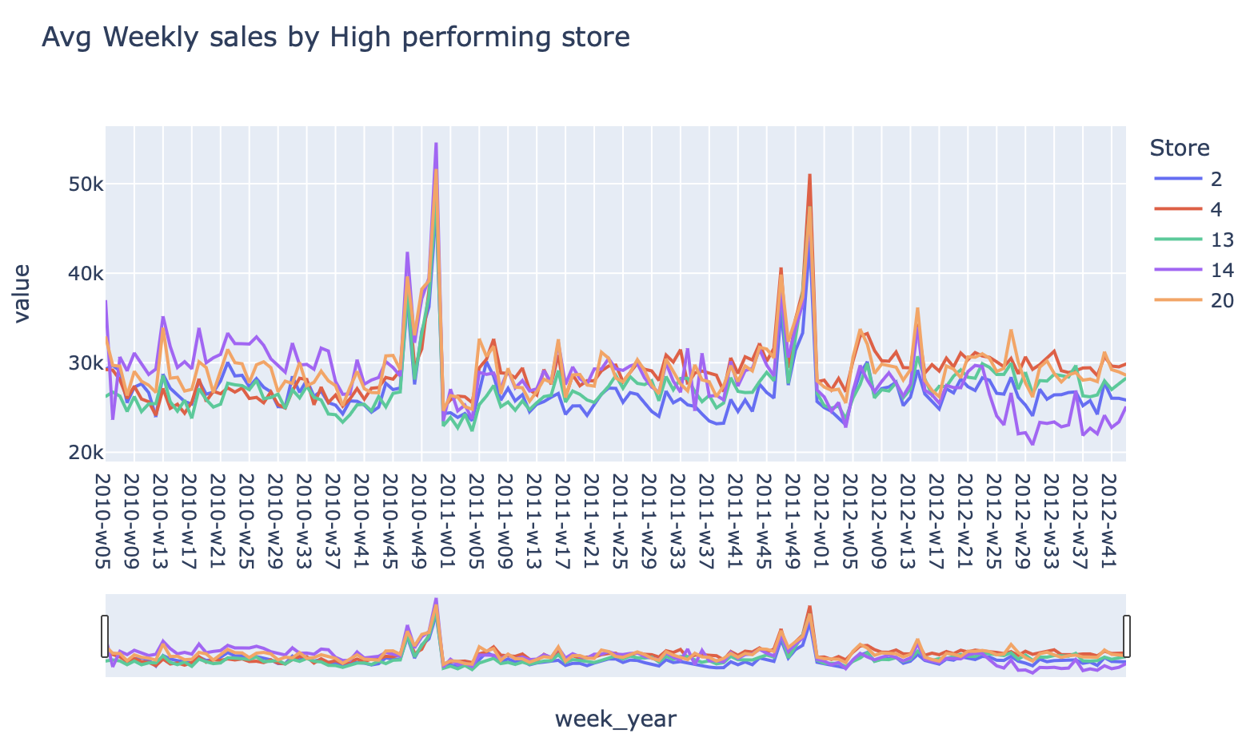
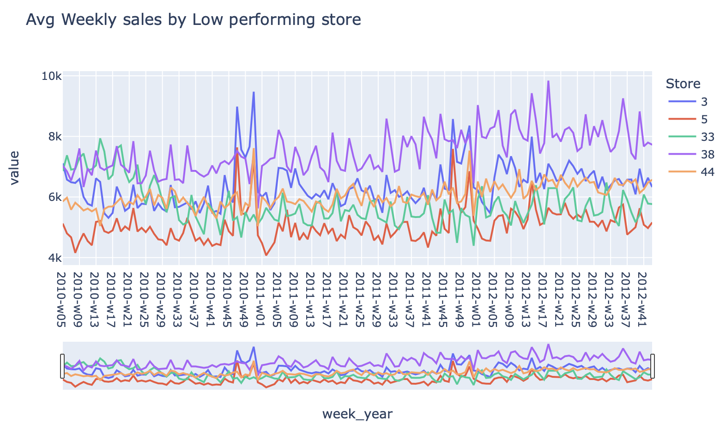
Insights: weekly_sales
Top 5 high performing store : End of each year we see a huge spike in sales [holiday sales]
Top 5 low preforming store : no seasonality but gradual increase till the end of the year

Slide 6
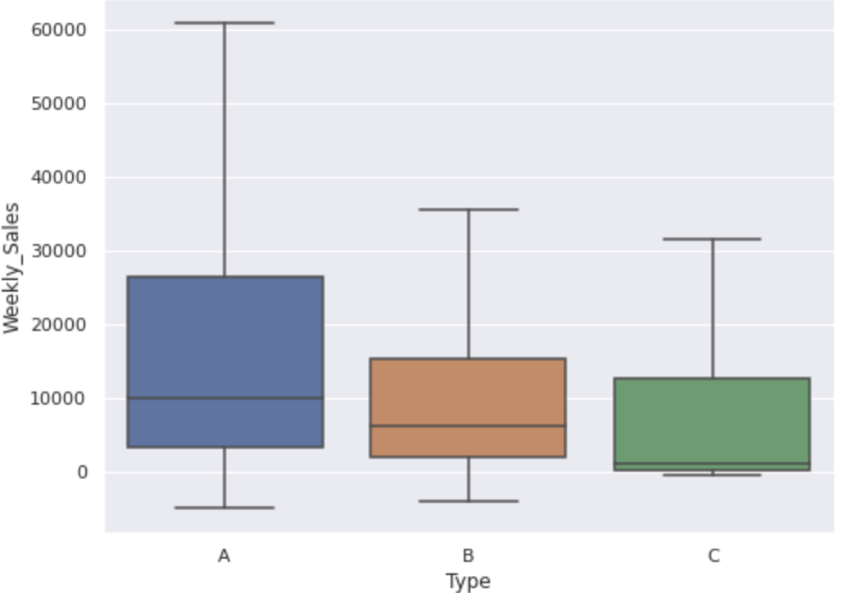
Insight: Store type
A stores have the highest sales with given mean and range, followed by B and C type of stores. Another key insight was store type C had the lowest sales, that needs to be further investigated.

Slide 7
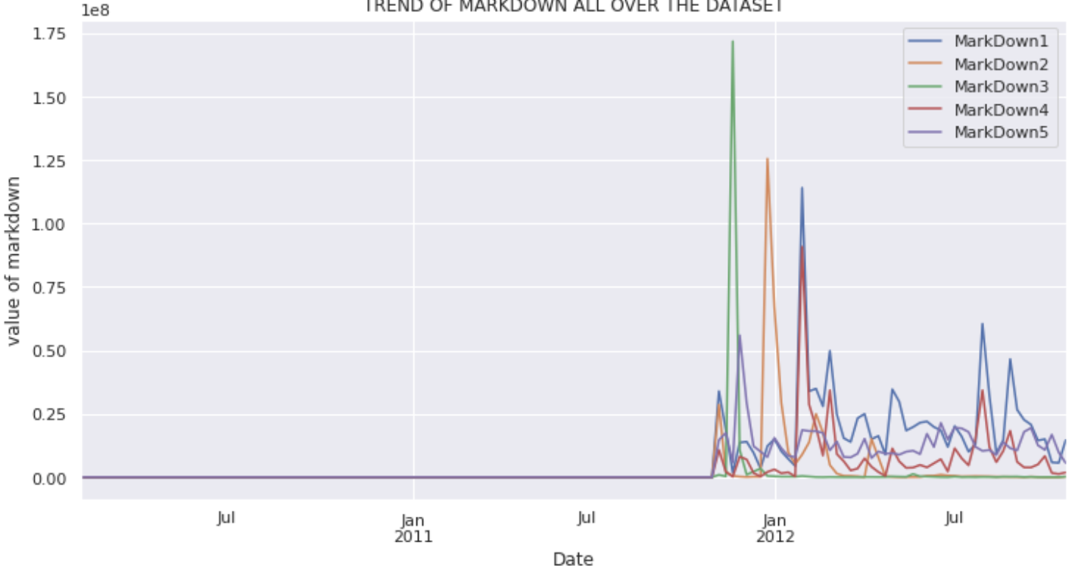
Insight: Markdown
Markdown on products didn’t start until the beginning of 2012. This could be some economical step to help drive sales up or some global issue.

Slide 8
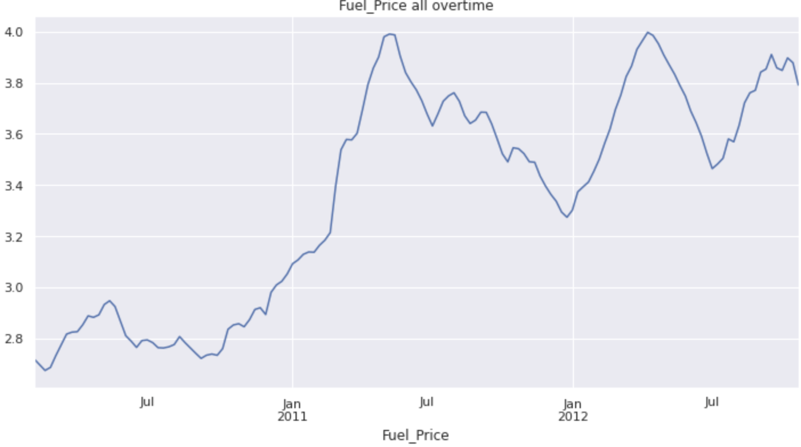
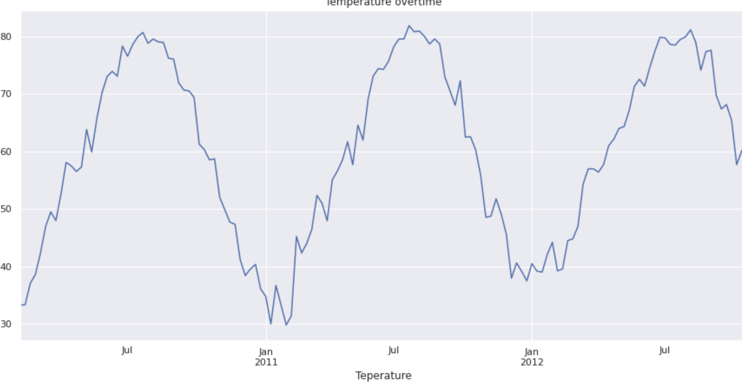
Insight: fuel price & temperature
Fuel prices increase overtime, and this could have an impact on sales, and it constrains the consumer from visiting the store as pricing increases.
Same logic can be applied towards temperature months with high temperature sales will be low as its less likely for consumers to shop at stores.

Slide 9
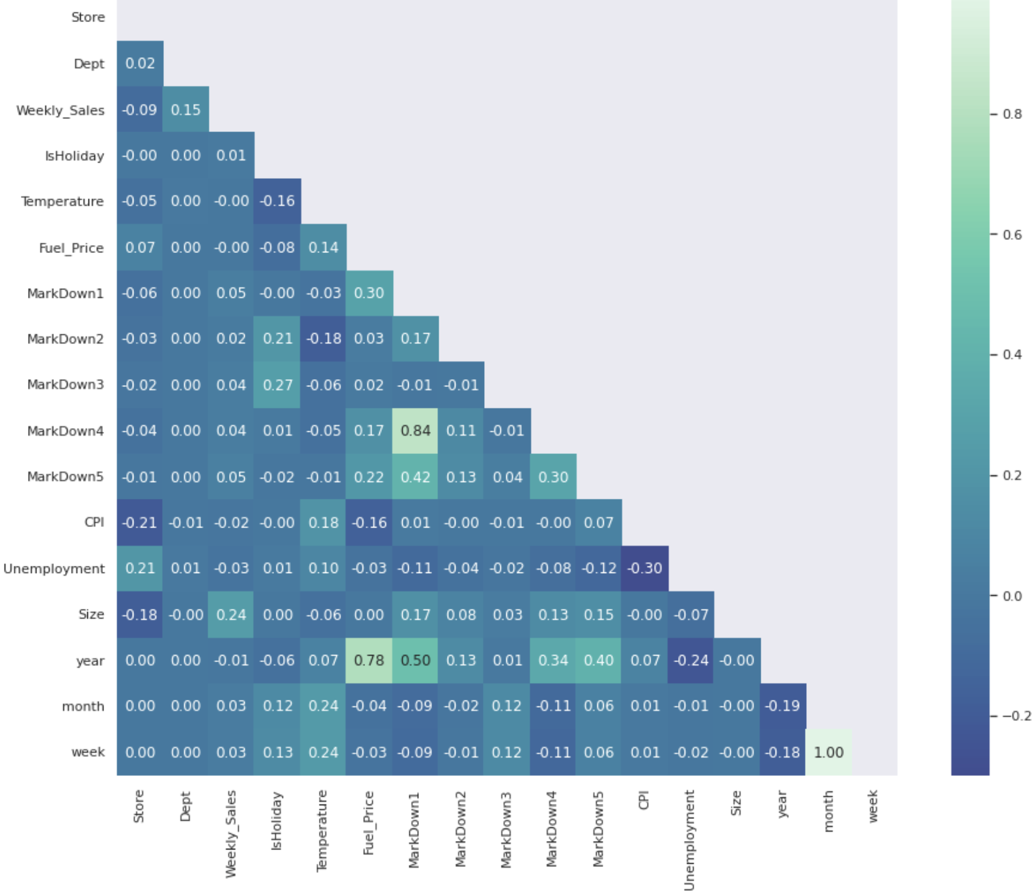
Insight: Correlation matrix
. The top positive correlations were size , debt and markdown compared to weekly_sales. These will need further investigation.

Slide 10
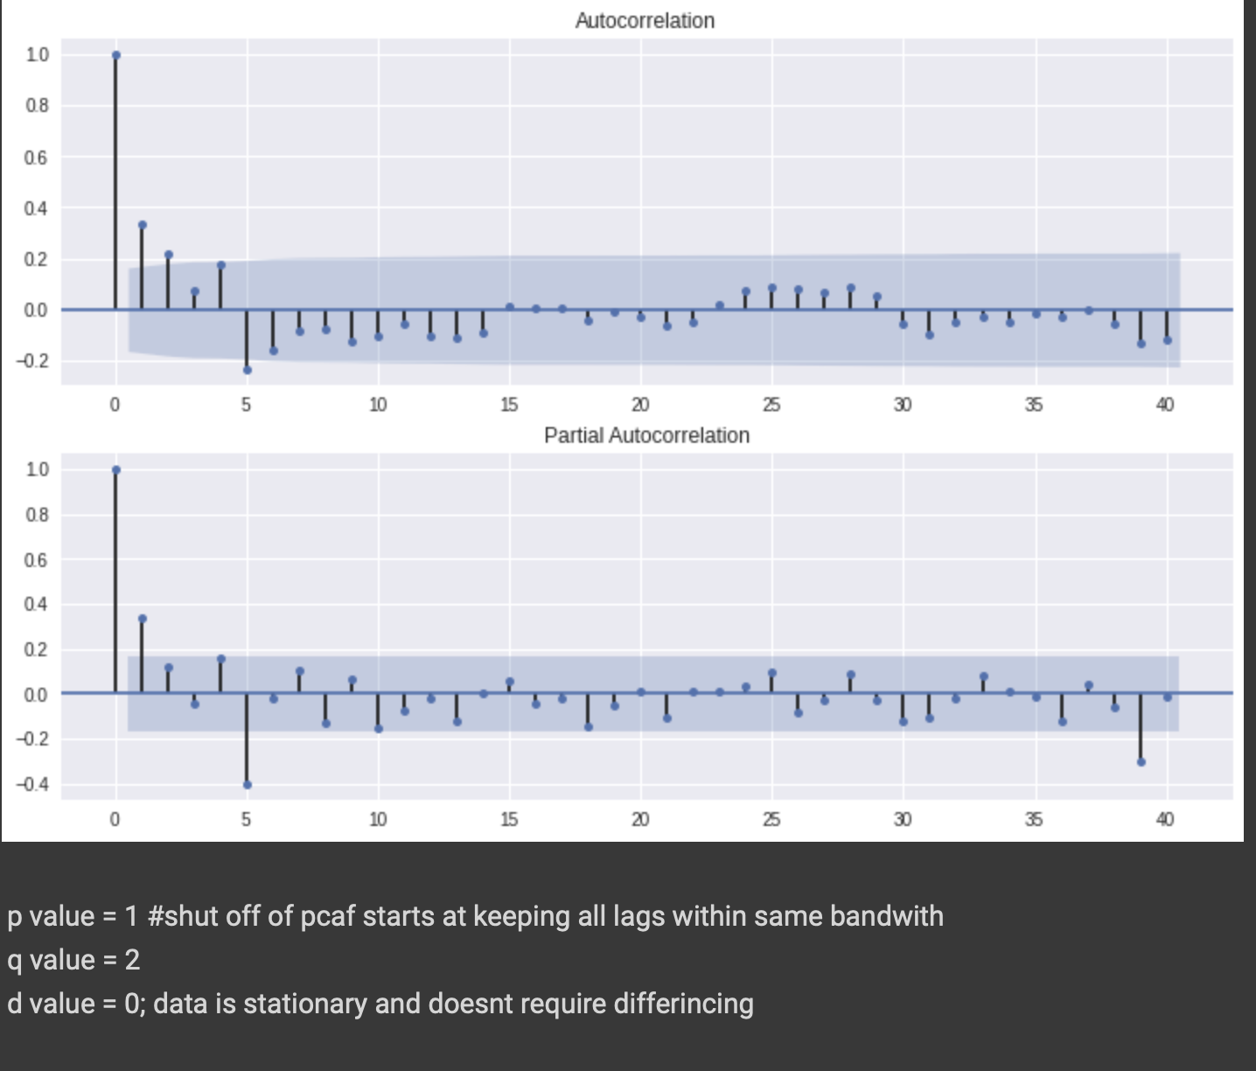
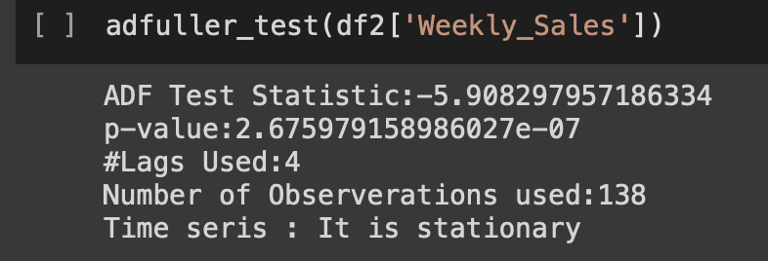
Pre-processing
Pdq value = 1,0,2 OBTAIN FROM THE GRAPHS
DICKEY FULLER TEST → P-VALUE < 0.05
DATA IS STATIONARY

Slide 11
modeling
Goals: create a ML model and FORECAST NEXT 6 MONTHS SALES.
CROSS VALIDATION for hyper tuning the model with parameters to get adequate results.
Model training/testing with 70/30 split.

Slide 12
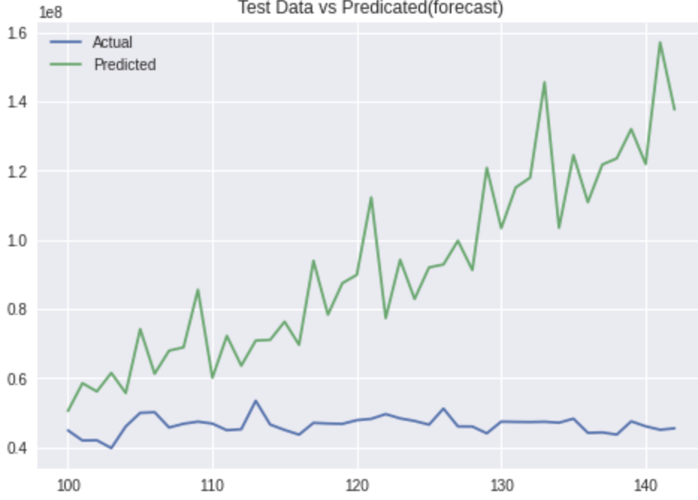
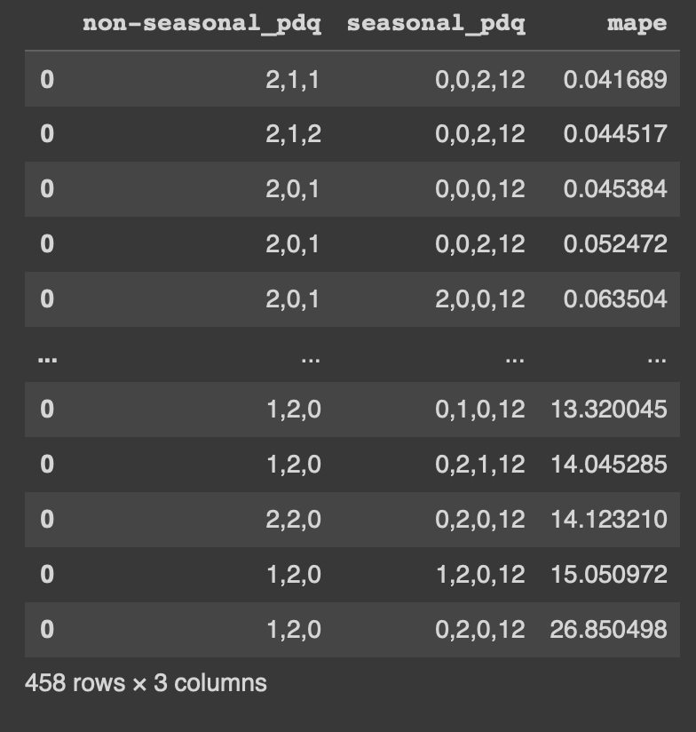
Hyper tuning model
WE ARE AIMING FOR A LOWEST MAPE OUTCOME WITH PDQ VALUES TO FIT A BEST MODEL.
PDQ = 2,1,1
PDQSEASONAL = 0,0,2,12
THIS GIVES US A LOWEST PERCENT ERROR FROM OUR ACTUAL DATA VALUES.

Slide 13
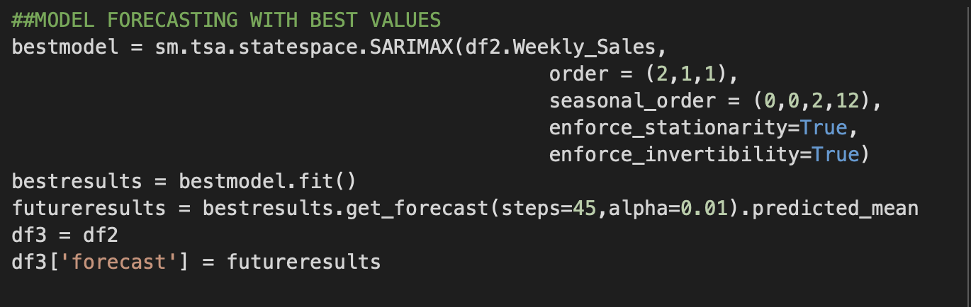
SARIMAX MODEL
WE USE THE BEST PDQ VALUES RUN THE MODEL AND SAVE IT AS BEST MODEL TO FIT AND FORECAST OUR NEXT MONTH SALES.

Slide 14
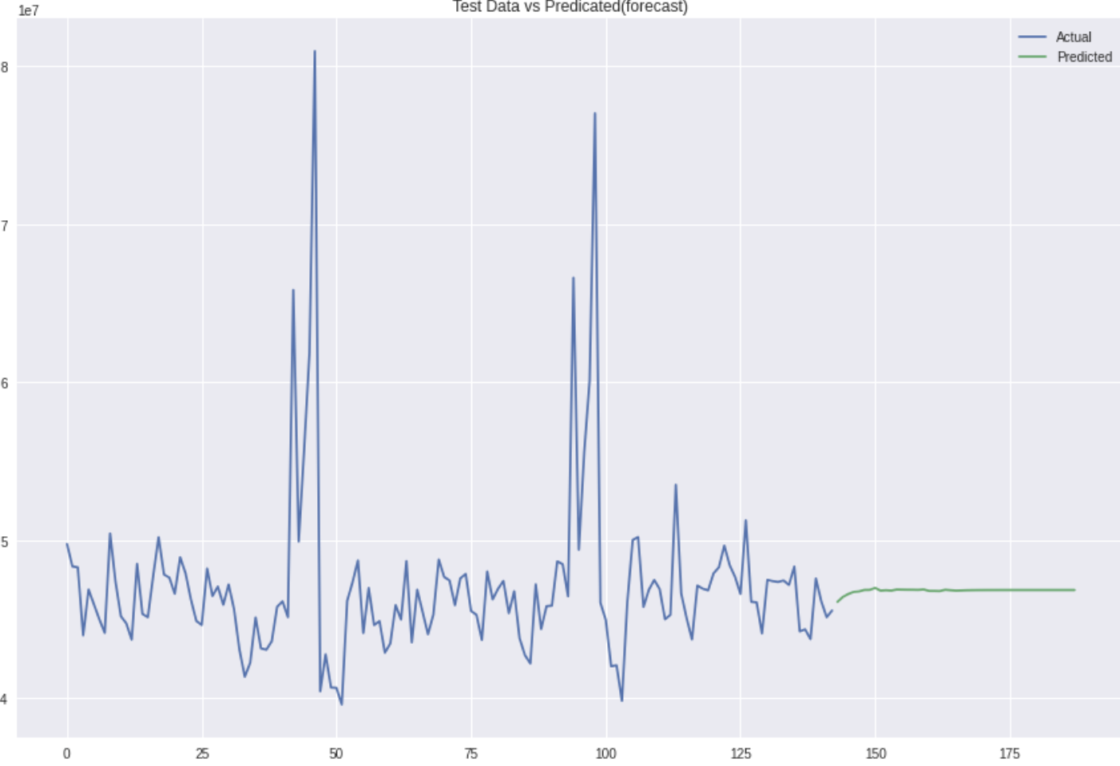
SARIMAX MODEL RESULTS

Slide 15
Conclusion/improvements
For future improvements we can test with a logistic regression or RANDOM FOREST to compare for the best model in production.
Model has room for improvement with data enrichment and different type of ML model to be used.
This model can help companies DRIVE SALES AND REVENUE BY PROJECTING IF THERE ARE ANY SHORTCOMING FOR THE YEAR.

